Slide 1
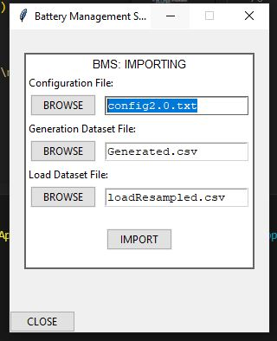
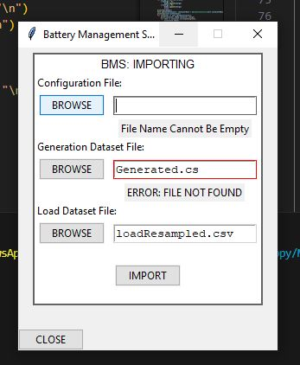
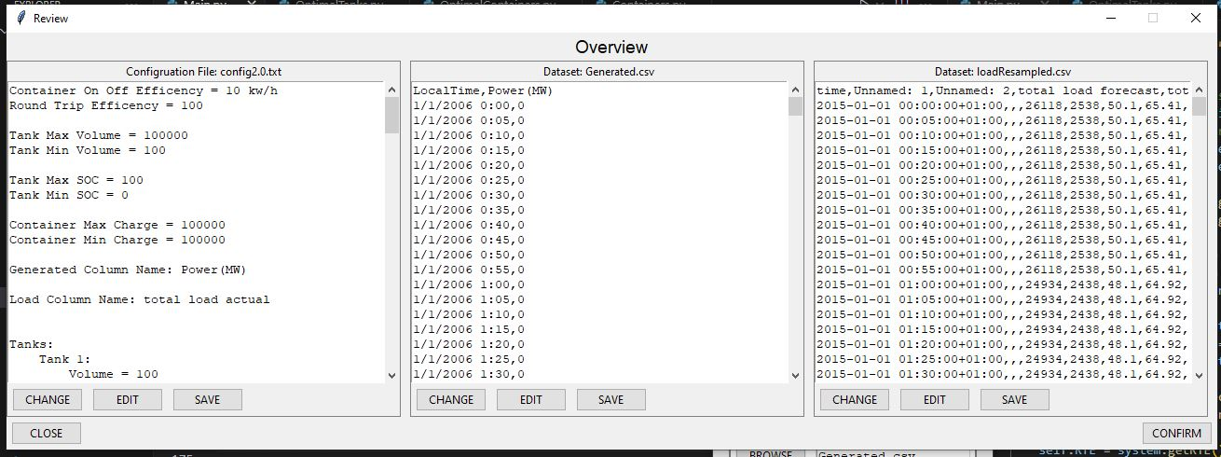
Software Demo

Slide 2
Initial Window
This is where you can choose what files to import
One must be a text file
The other two must be csv files
If files not saved where the executable file is, then you will not be able to find it unless you use the absolute path of the file eg
G:\UNI\YR4\WIL B\textfile.txt

Slide 3
Review Window
In this window it will allow you to review the files chosen, either to make edits or change the files.
You can also go back to the first screen as well to choose the files from there.
if you edit in the widgets provided you will need to press the save

Slide 4
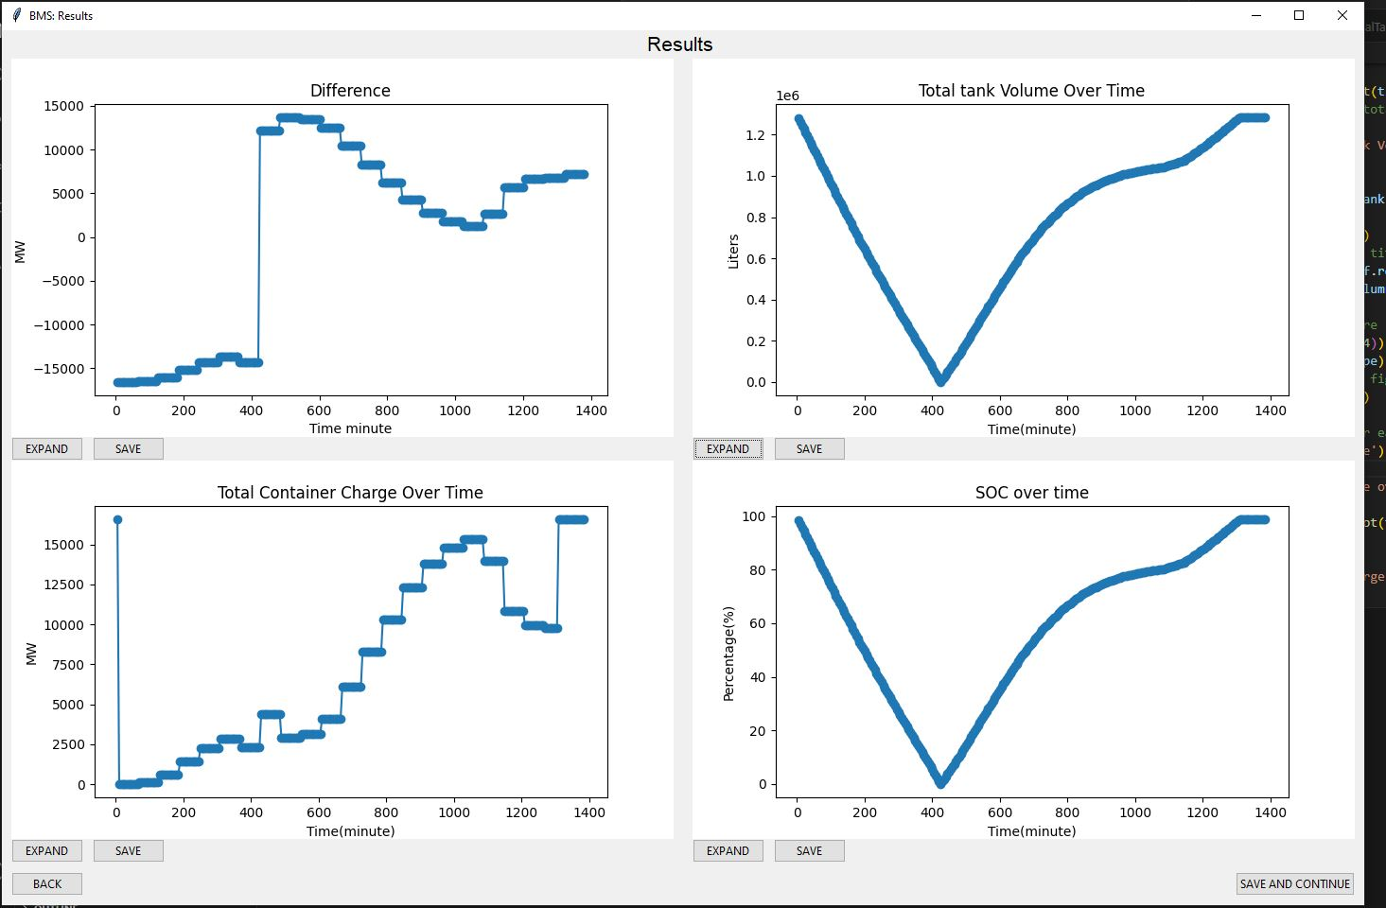
Results Window
This is the results window.
It will show the graphs of various critical functions to better communicate the results
You can choose where to save each individual graph or expand them to go into more detail for the container, soc and tanks graphs
Pressing back will take you back to the initial window
And save and continue will allow you to choose a place to save the tanks, containers and initial conditions.

Slide 5
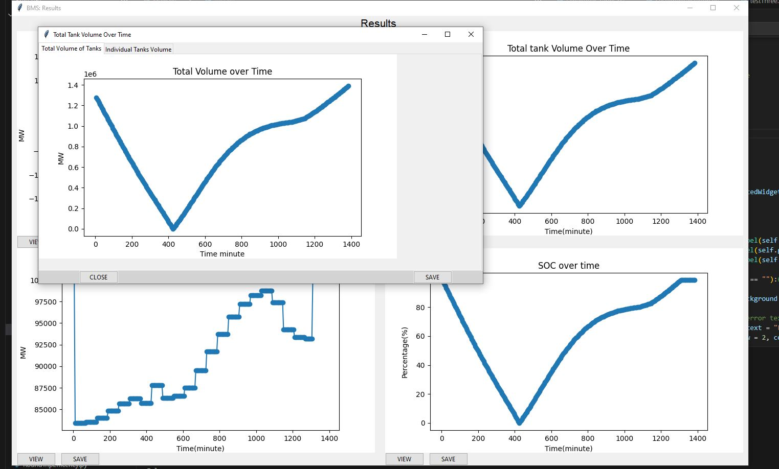
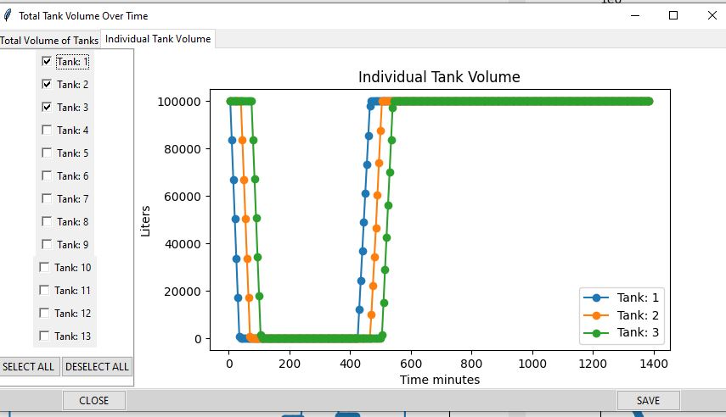
Expanded Graphs
Below are two graphs seen when the expanded button is pressed
The left is what all the expanded graphs do and allows for saving and closing
The right is the tanks, containers and soc for individual containers. In this you can de-select all or select all to show each tank and how it operates during the storage and expenditure of the energy
Both graphs can be saved similarly to that of the Results Window

